Slide 1
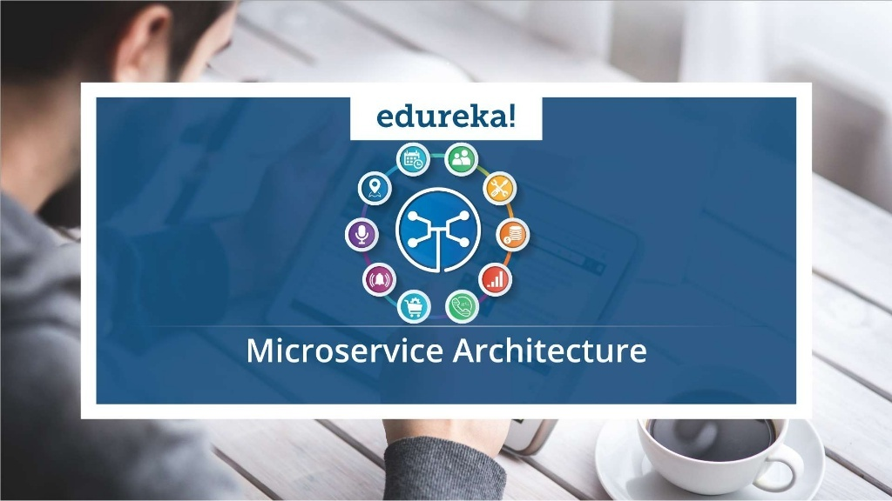

Slide 2
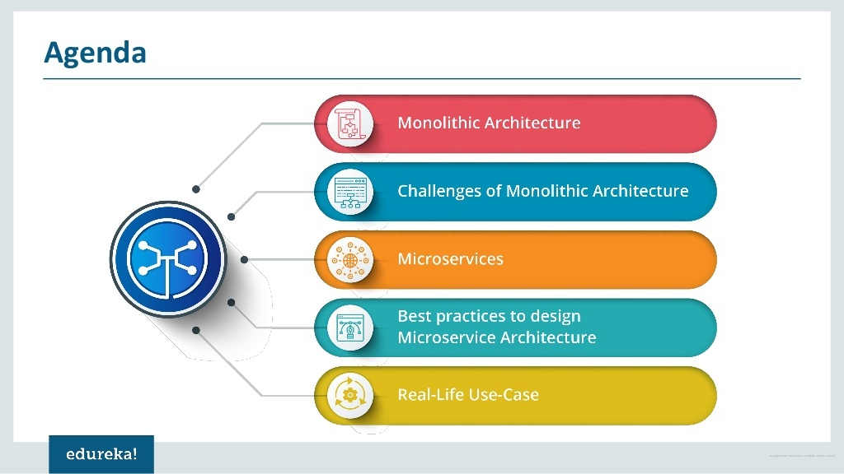

Slide 3


Slide 4
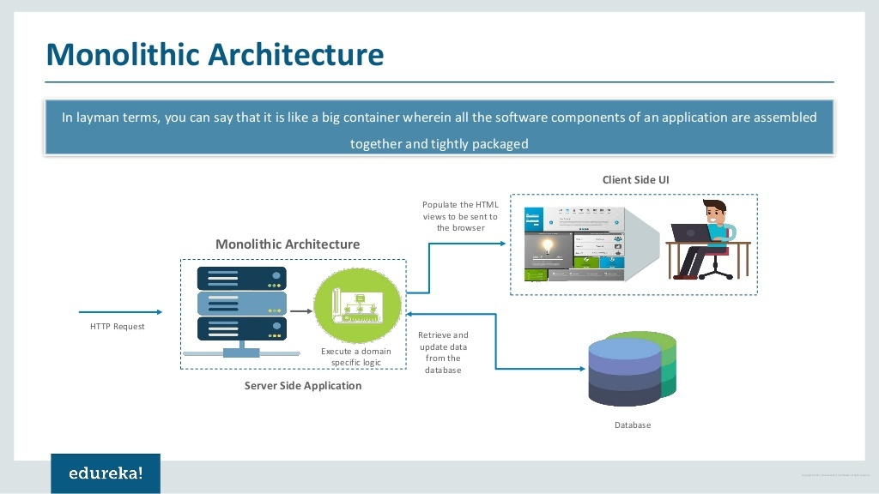

Slide 5
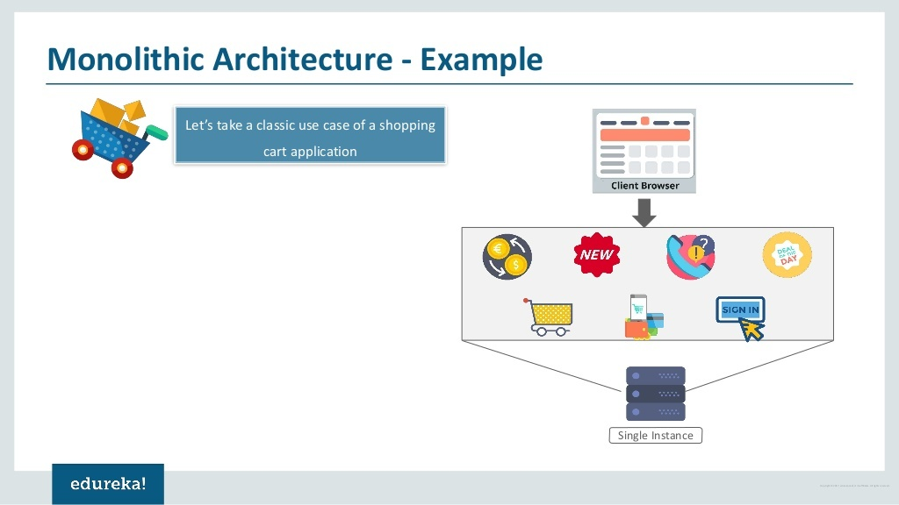
All the features in the Shopping Cart Application like Sign In, Shopping Cart, Payment, Offers are under a single instance sharing a single database using single code.

Slide 6


Slide 7
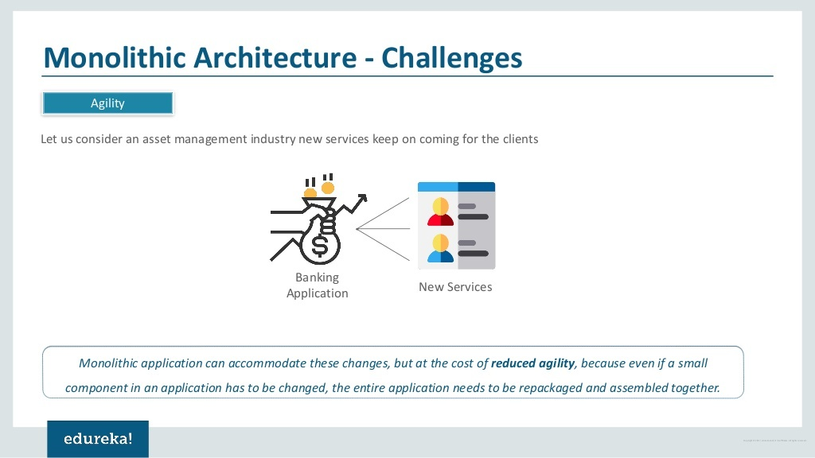

Slide 8
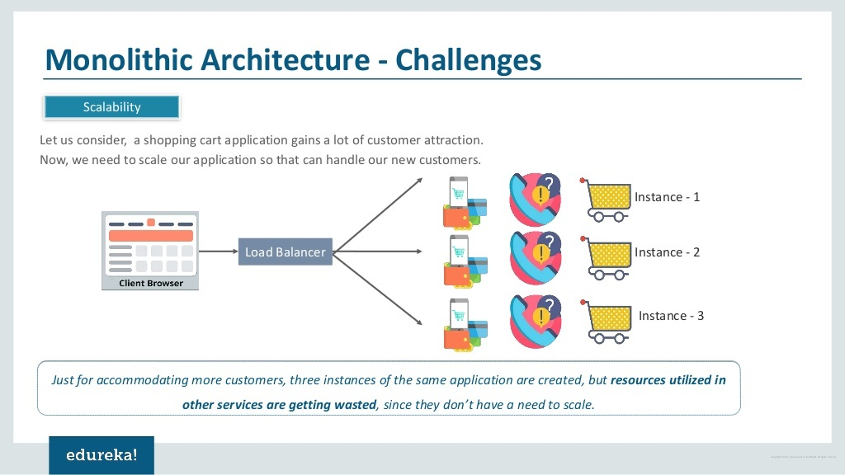

Slide 9
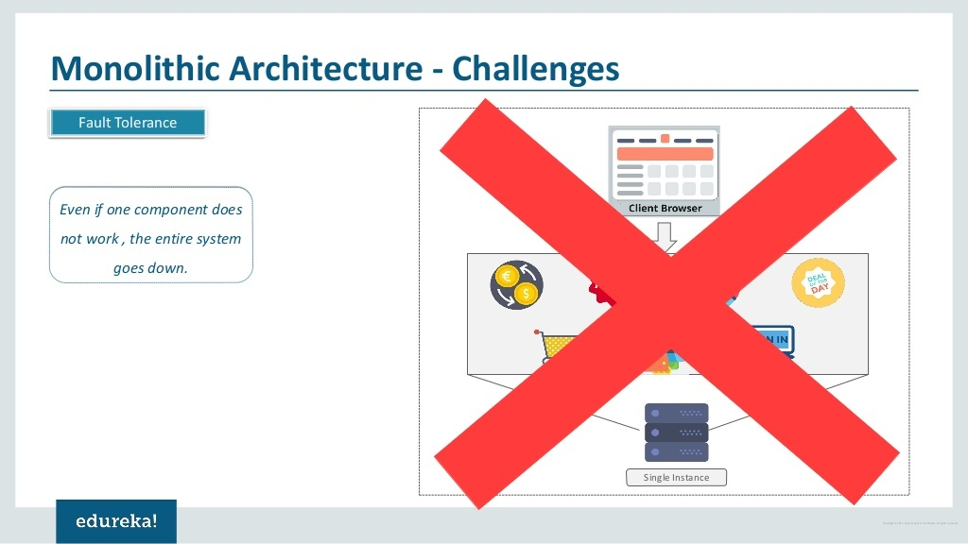

Slide 10
Monolithic Architecture Challenges
Hybrid Technologies:
Suppose developers of this application are comfortable with various technologies like JAVA, C++,.NET, C#.
Even though they are comfortable with various technologies, they still have to build large and complex applications on a single technology.

Slide 11
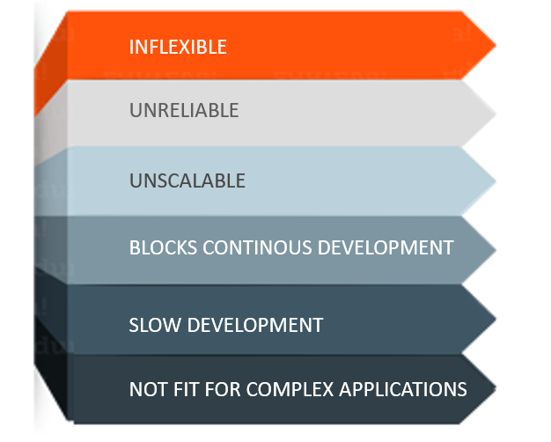
Challenges of Monolithic Architecture

Slide 12
Challenges of Monolithic Architecture
Inflexible – Monolithic applications cannot be built using different technologies
Unreliable – Even if one feature of the system does not work, then the entire system does not work
Unscalable – Applications cannot be scaled easily since each time the application needs to be updated, the complete system has to be rebuilt
Blocks Continous Development – Many features of the applications cannot be built and deployed at the same time
Slow Development – Development in monolithic applications take lot of time to be built since each and every feature has to be built one after the other
Not Fit For Complex Applications – Features of complex applications have tightly coupled dependencies
The above challenges were the main reasons that led to the evolution of microservices.

Slide 13


Slide 14
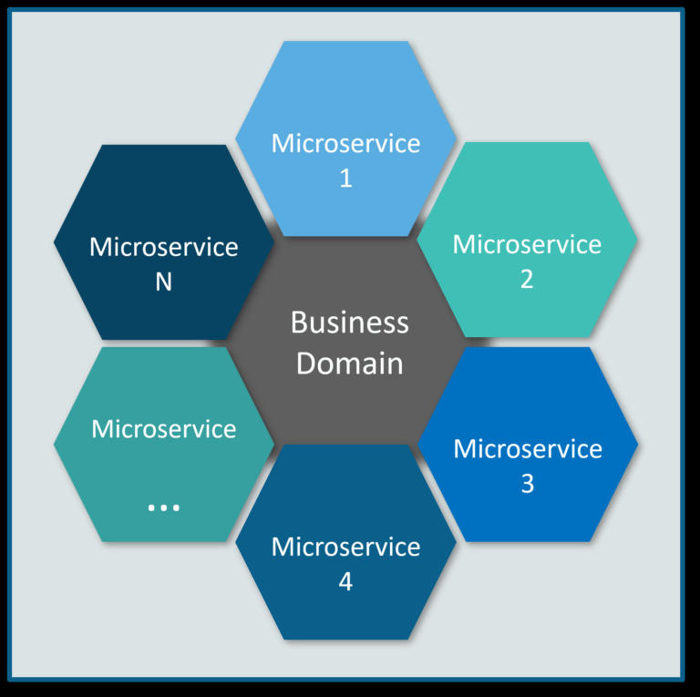
What exactly is Microservices?
Microservices is an architectural style that structures an application as a collection of small autonomous services, modelled around a business domain.
In the given Architecture, each service is self-contained and implements a single business capability.

Slide 15
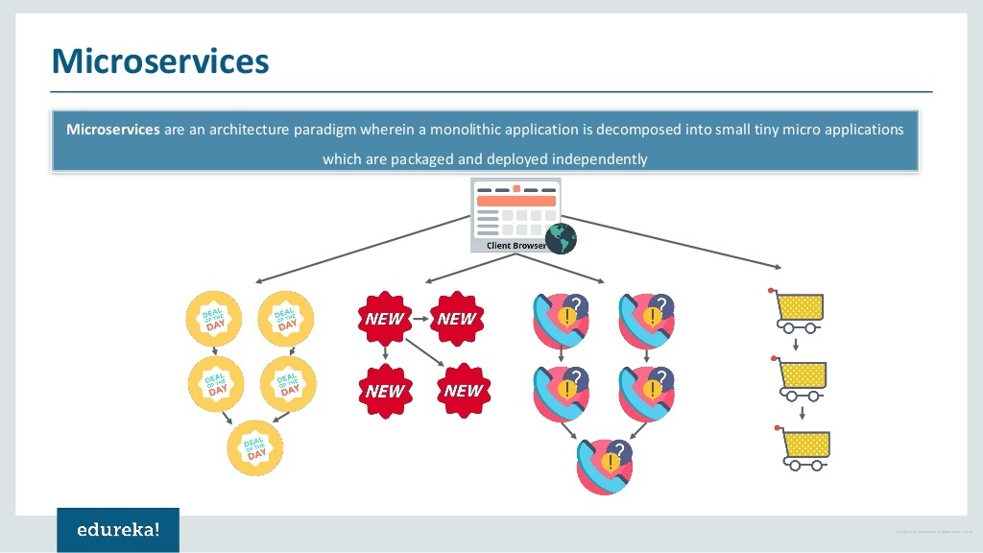

Slide 16
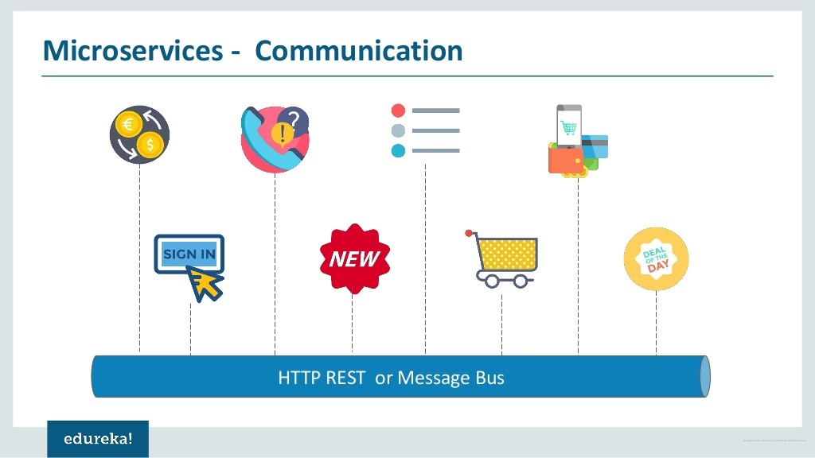

Slide 17
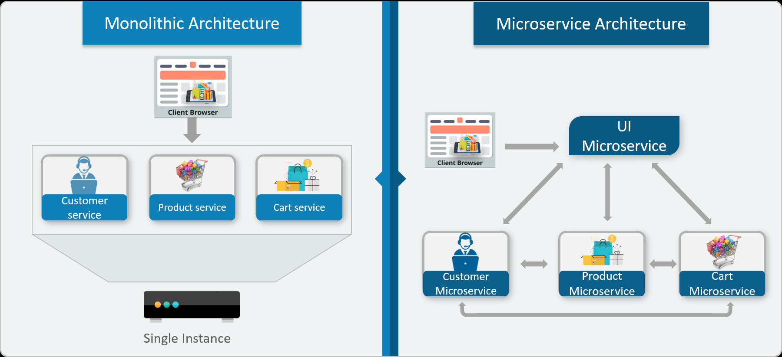
Differences Between Traditional Architecture and Microservices
Consider an E-commerce application as a use-case to understand the difference between both of them.
The main difference we observe in the above diagram is that all the features initially were under a single instance sharing a single database.
But then, with microservices, each feature was allotted a different microservice, handling their own data, and performing different functionalities.

Slide 18
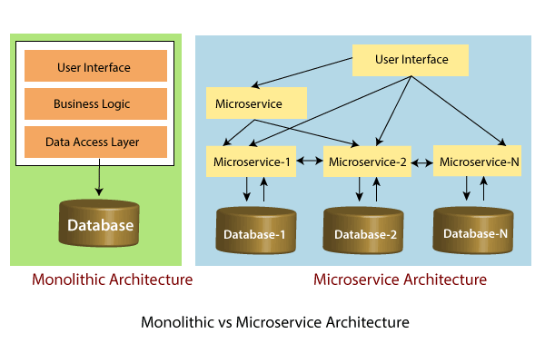

Slide 19
Service-Oriented Architecture
Service-Oriented Architecture (SOA) is an architectural approach in which applications make use of services available in the network.
In this architecture, services are provided to form applications, through a communication call over the internet.
SOA allows users to combine a large number of facilities from existing services to form applications.
SOA encompasses a set of design principles that structure system development and provide means for integrating components into a coherent and decentralized system.
SOA based computing packages functionalities into a set of interoperable services, which can be integrated into different software systems belonging to separate business domains.

Slide 20
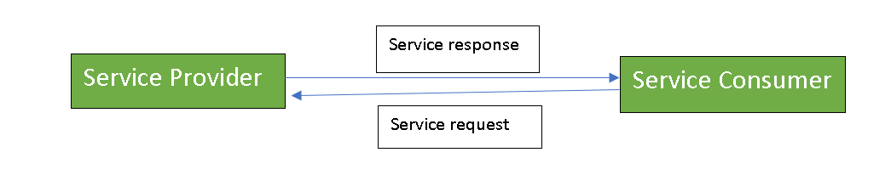
Service-Oriented Architecture
There are two major roles within Service-oriented Architecture:
Service provider: The service provider is the maintainer of the service and the organization that makes available one or more services for others to use.
To advertise services, the provider can publish them in a registry, together with a service contract that specifies the nature of the service, how to use it, the requirements for the service, and the fees charged.
Service consumer: The service consumer can locate the service metadata in the registry and develop the required client components to bind and use the service.

Slide 21
Introduction to Microservices
Microservice Architecture is a Service Oriented Architecture.
In the microservice architecture, there are a large number of microservices.
By combining all the microservices, it constructs a big service.
In the microservice architecture, all the services communicate with each other.

Slide 22
What are Microservices
Definition: According to Sam Newman, "Microservices are the small services that work together."
According to James Lewis and Martin Fowler, "The microservice architectural style is an approach to develop a single application as a suite of small services.
Each microservice runs its process and communicates with lightweight mechanisms.
These services are built around business capabilities and independently developed by fully automated deployment machinery."

Slide 23
Points to remember in Micro Services
These are the services which are exposed by REST.
These are small well-chosen deployable units.
The services must be cloud-enabled.
The microservice defines an approach to the architecture that divides an application into a pool of loosely coupled services that implements business requirements.
It is next to Service-Oriented Architecture (SOA).
The most important feature of the microservice-based architecture is that it can perform continuous delivery of a large and complex application.

Slide 24
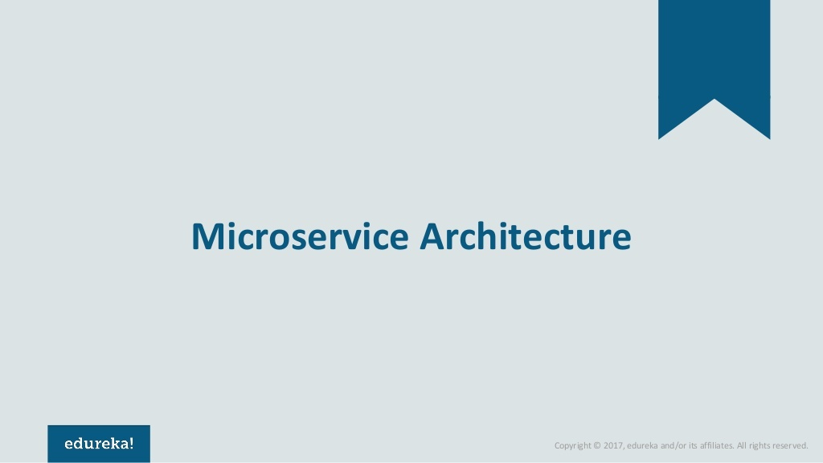
Microservices is an architecture wherein all the components of the system are put into individual components, which can be built, deployed, and scaled individually.

Slide 25
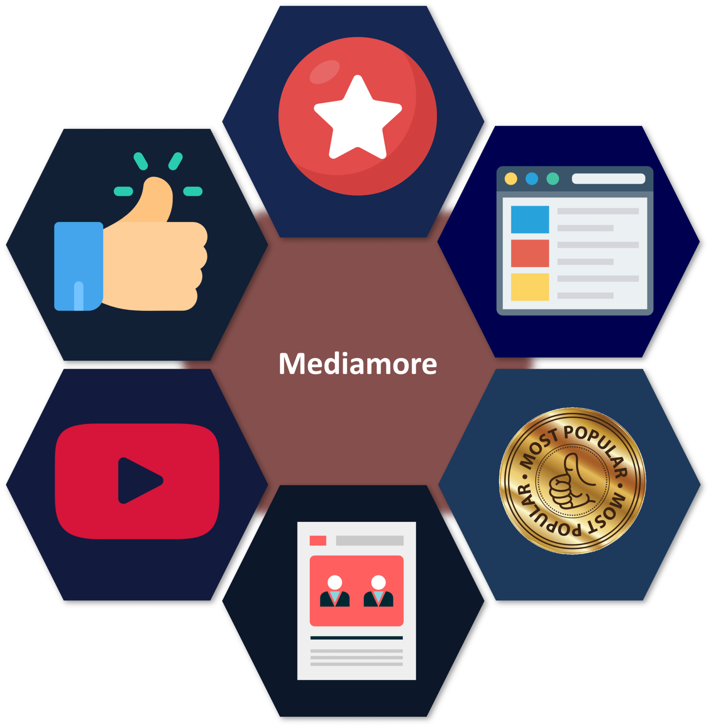
Micro Services Comparison with simple analogy
You must have seen how bees build their honeycomb by aligning hexagonal wax cells.
They initially start with a small section using various materials and continue to build a large beehive out of it.
These cells form a pattern resulting in a strong structure which holds together a particular section of the beehive.
Here, each cell is independent of the other but it is also correlated with the other cells.
This means that damage to one cell does not damage the other cells, so, bees can reconstruct these cells without impacting the complete beehive.

Slide 26
Here, each hexagonal shape represents an individual service component.
Similar to the working of bees, each agile team builds an individual service component with the available frameworks and the chosen technology stack.
Just as in a beehive, each service component forms a strong microservice architecture to provide better scalability.
Issues with each service component can be handled individually by the agile team with no or minimal impact on the entire application.

Slide 27
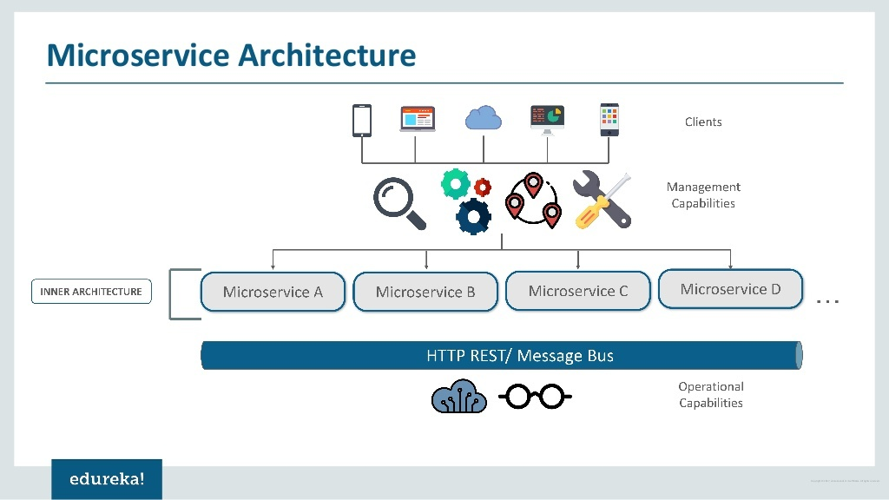

Slide 28
Micro Services Architecture
Different clients from different devices try to use different services like search, build, configure and other management capabilities
All the services are separated based on their domains and functionalities and are further allotted to individual microservices
These microservices have their own load balancer and execution environment to execute their functionalities & at the same time captures data in their own databases
All the microservices communicate with each other through a stateless server which is either REST or Message Bus
Microservices know their path of communication with the help of Service Discovery and perform operational capabilities such as automation, monitoring
Then all the functionalities performed by microservices are communicated to clients via API Gateway
All the internal points are connected from the API Gateway.
So, anybody who connects to the API Gateway automatically gets connected to the complete system

Slide 29
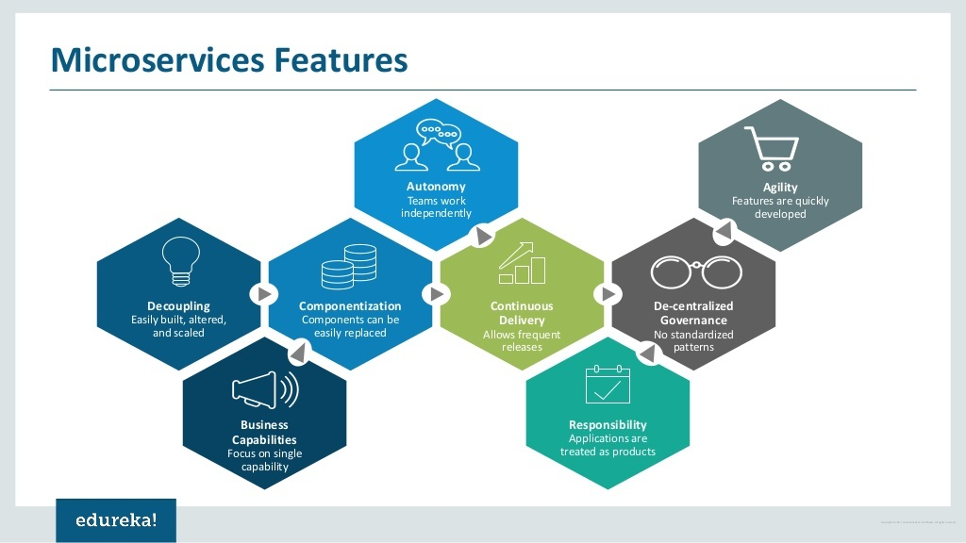

Slide 30
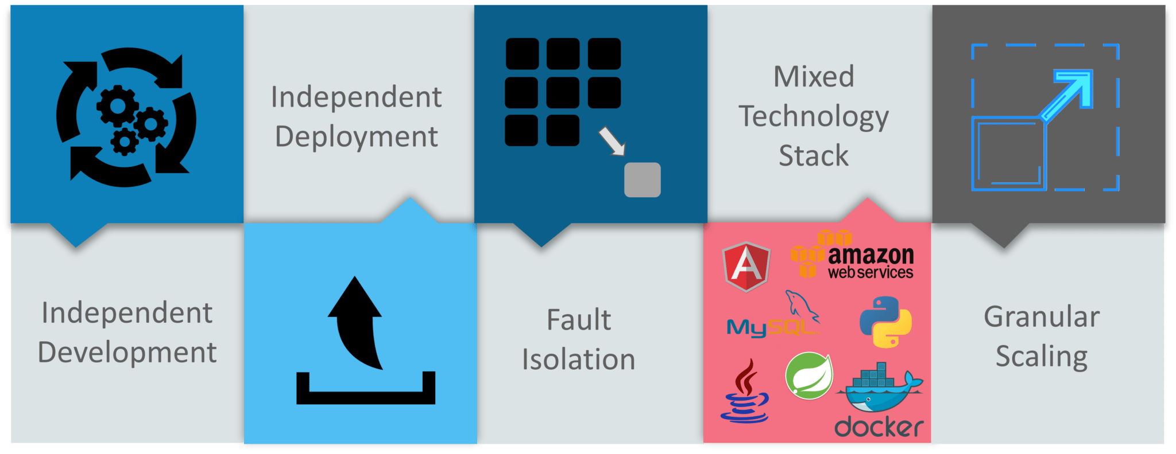
Advantages Of Microservices
Independent Development – All microservices can be easily developed based on their individual functionality.
Independent Deployment – Based on their services, they can be individually deployed in any application.
Fault Isolation – Even if one service of the application does not work, the system still continues to function.
Mixed Technology Stack – Different languages and technologies can be used to build different services of the same application.
Granular Scaling – Individual components can scale as per need, there is no need to scale all components together

Slide 31
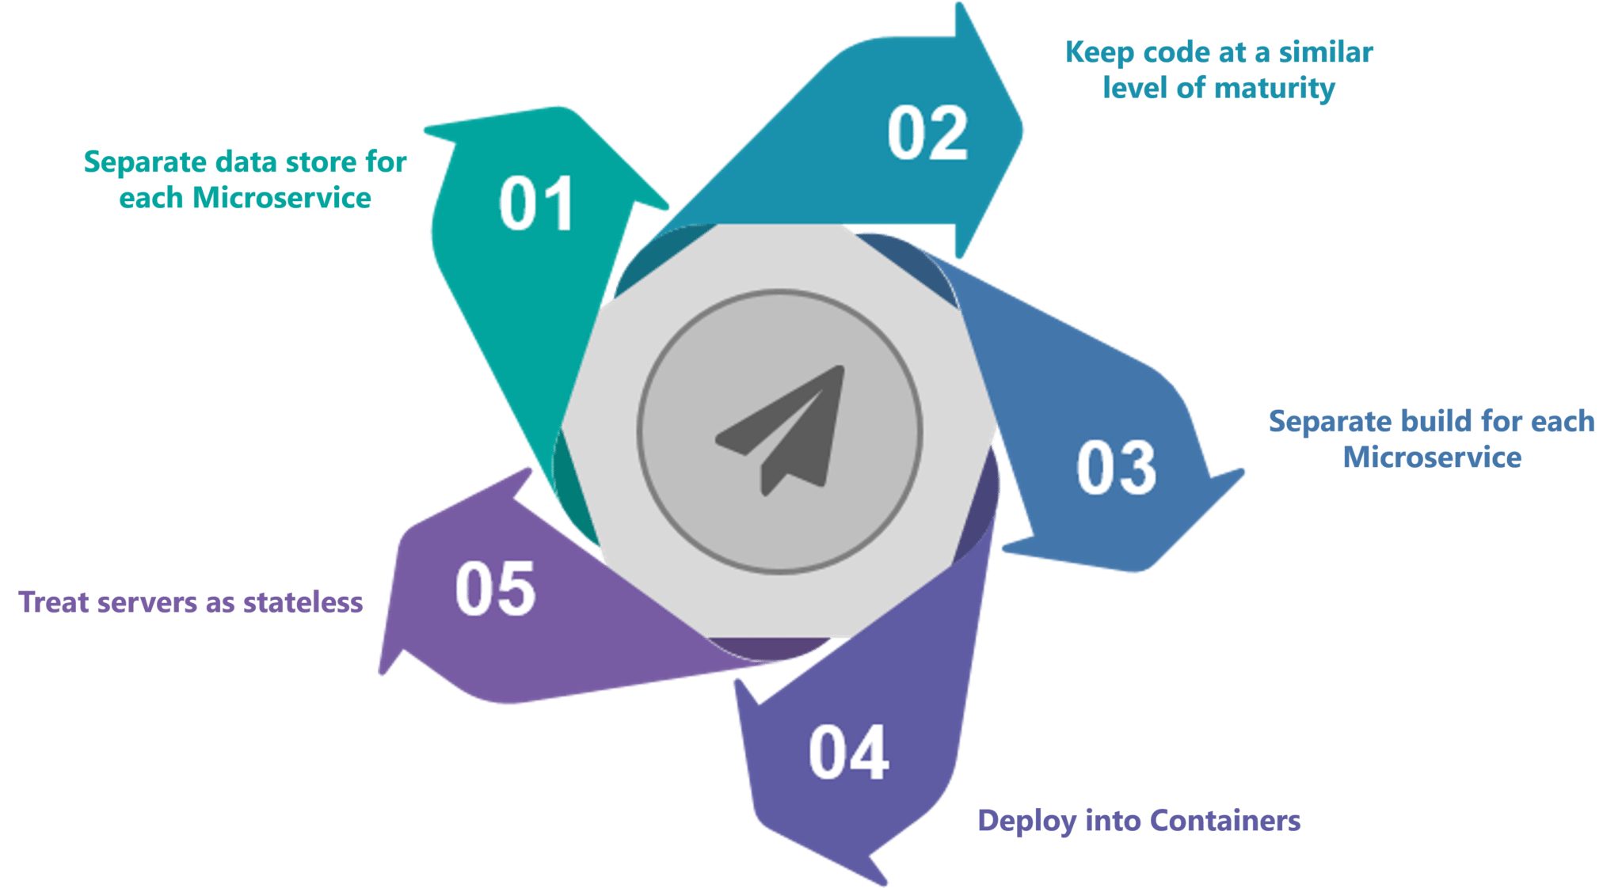
Best Practices to Design Microservices?
In today’s world, complexity has managed to creep into products.
Microservice architecture promises to keep teams scaling and function better.

Slide 32
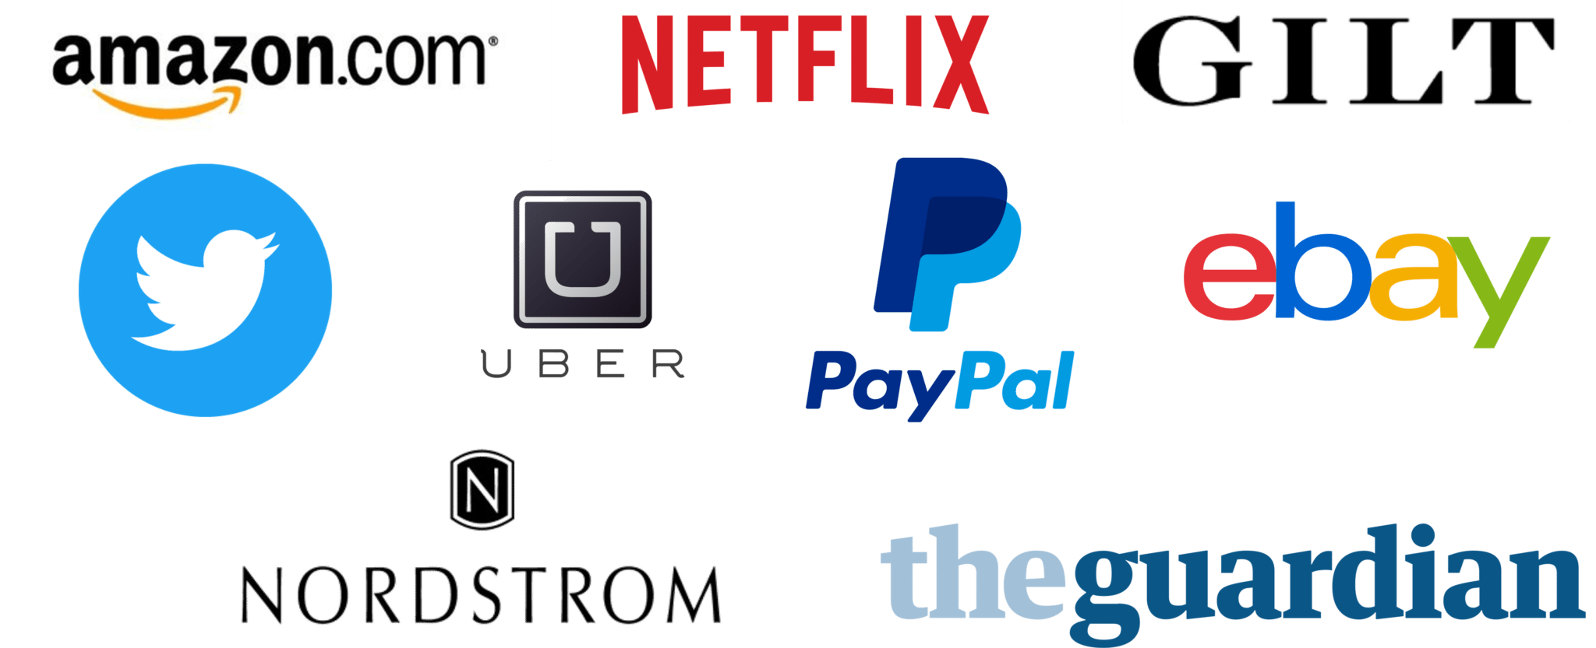
Companies using Microservices

Slide 33


Slide 34
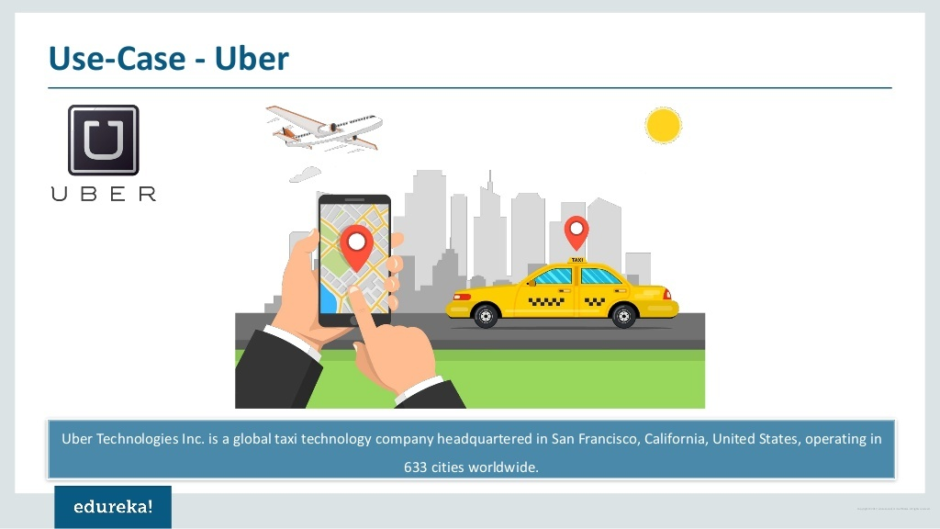

Slide 35
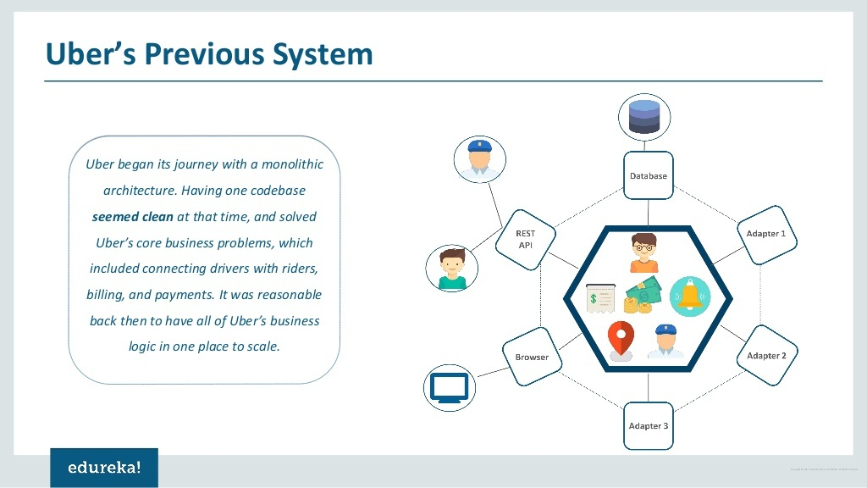

Slide 36
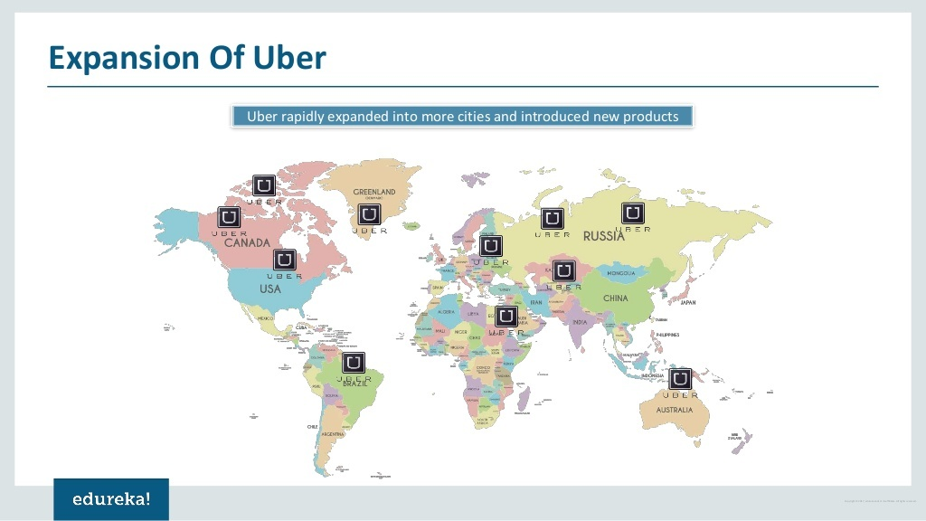

Slide 37
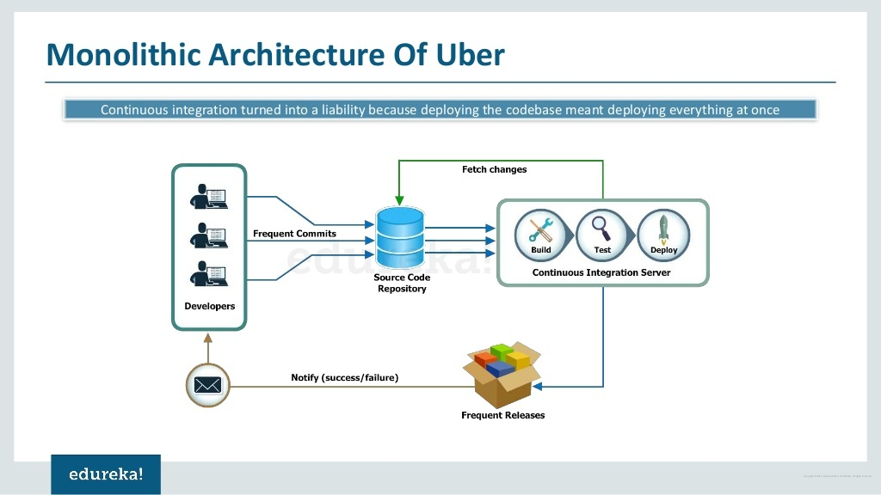

Slide 38
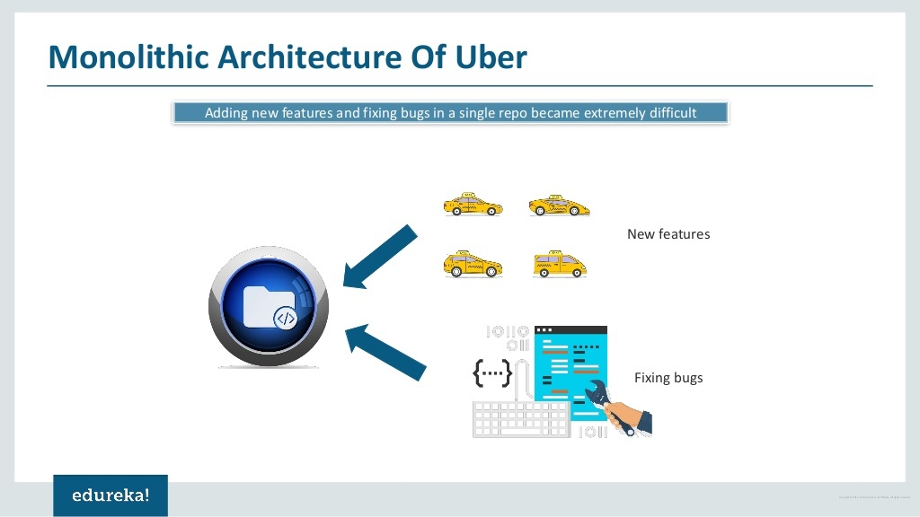

Slide 39
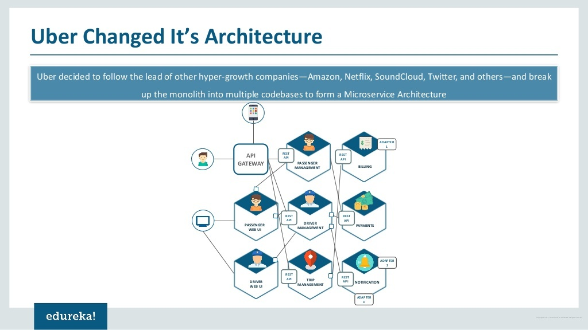

Slide 40


Slide 41
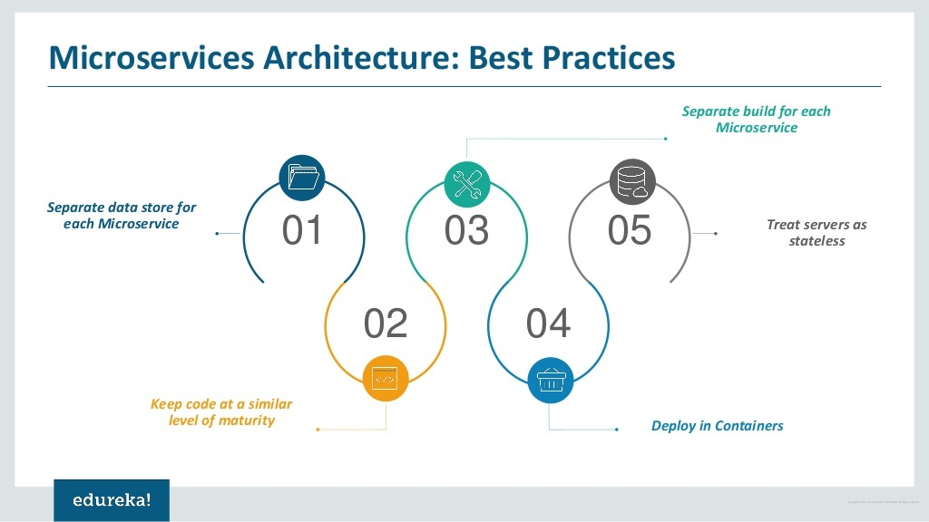

Slide 42
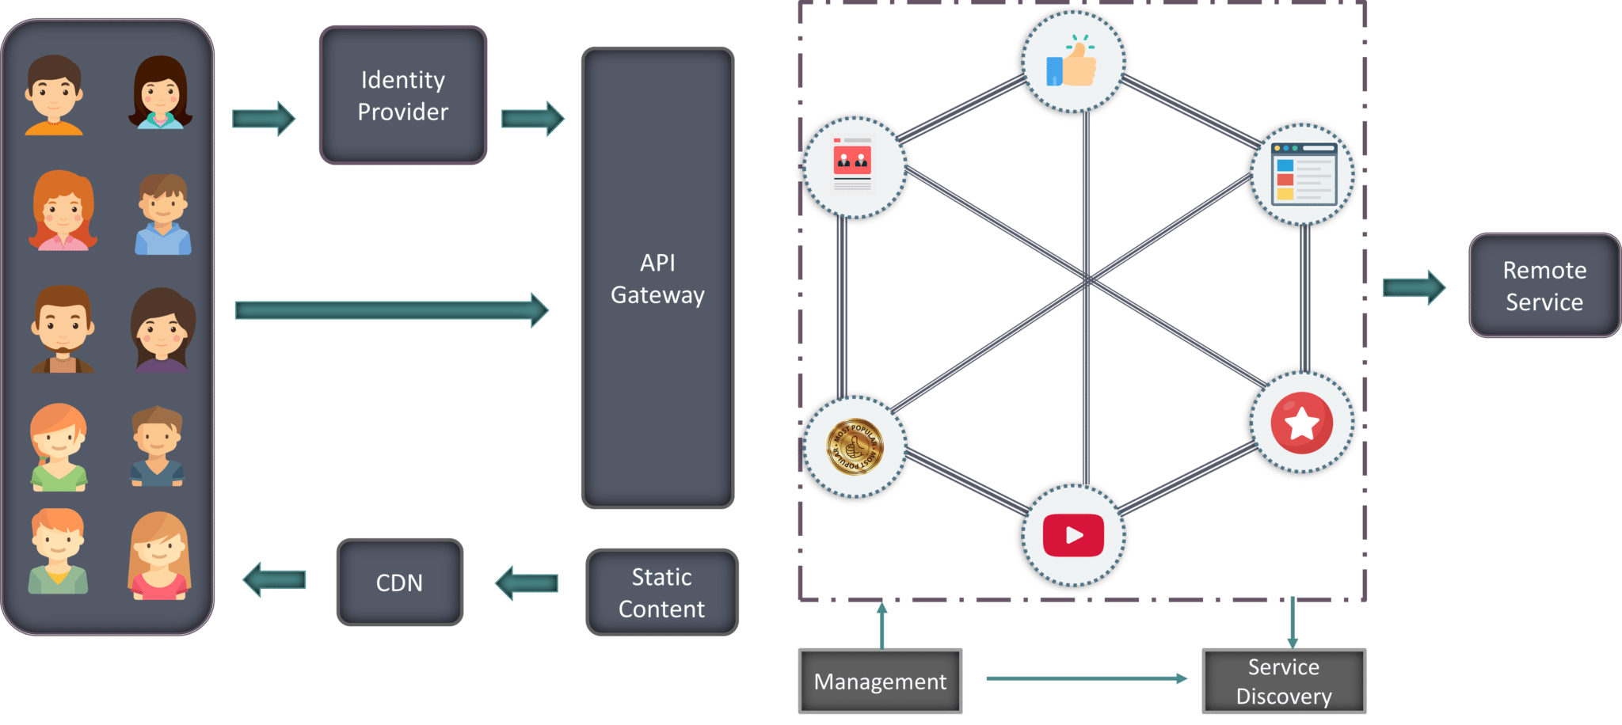
Components of the Microservice Architecture.

Slide 43
Components of the Microservice Architecture.
Clients – Different users from various devices send requests.
Identity Providers – Authenticates user or clients identities and issues security tokens.
API Gateway – Handles client requests.
Static Content – Houses all the content of the system.
Management – Balances services on nodes and identifies failures.
Service Discovery – A guide to find the route of communication between microservices.
Content Delivery Networks – Distributed network of proxy servers and their data centers.
Remote Service – Enables the remote access information that resides on a network of IT devices.

Slide 44
Microservice Architecture Scenario
Mediamore is an entertainment company which provides streaming media and videos online.
It consists of various genres of TV Shows in different languages.
Alice is an avid user of mediamore.
She uses mediamore regularly to watch her favorite series online.
She recently missed watching an episode of her favorite TV show.
When Alice logs in to the application, she sees the most recommended content on her home page.
After some searching, she finally finds her TV Show.
But, what if Alice wants to get her TV Show with a single click.

Slide 45
How will the developers work together to fulfill Alice’s request?
Alice’s request is passed on to the Identity Provider.
Identity provider thus authenticates Alice’s request by identifying her as a regular user on mediamore.
These requests are passed to the API Gateway which acts as an entry point for Alice to forward her requests to the appropriate microservices.
Each feature has its own working microservice, handling their own data.
These microservices also have their own load balancers and execution environments to function properly.

Slide 46
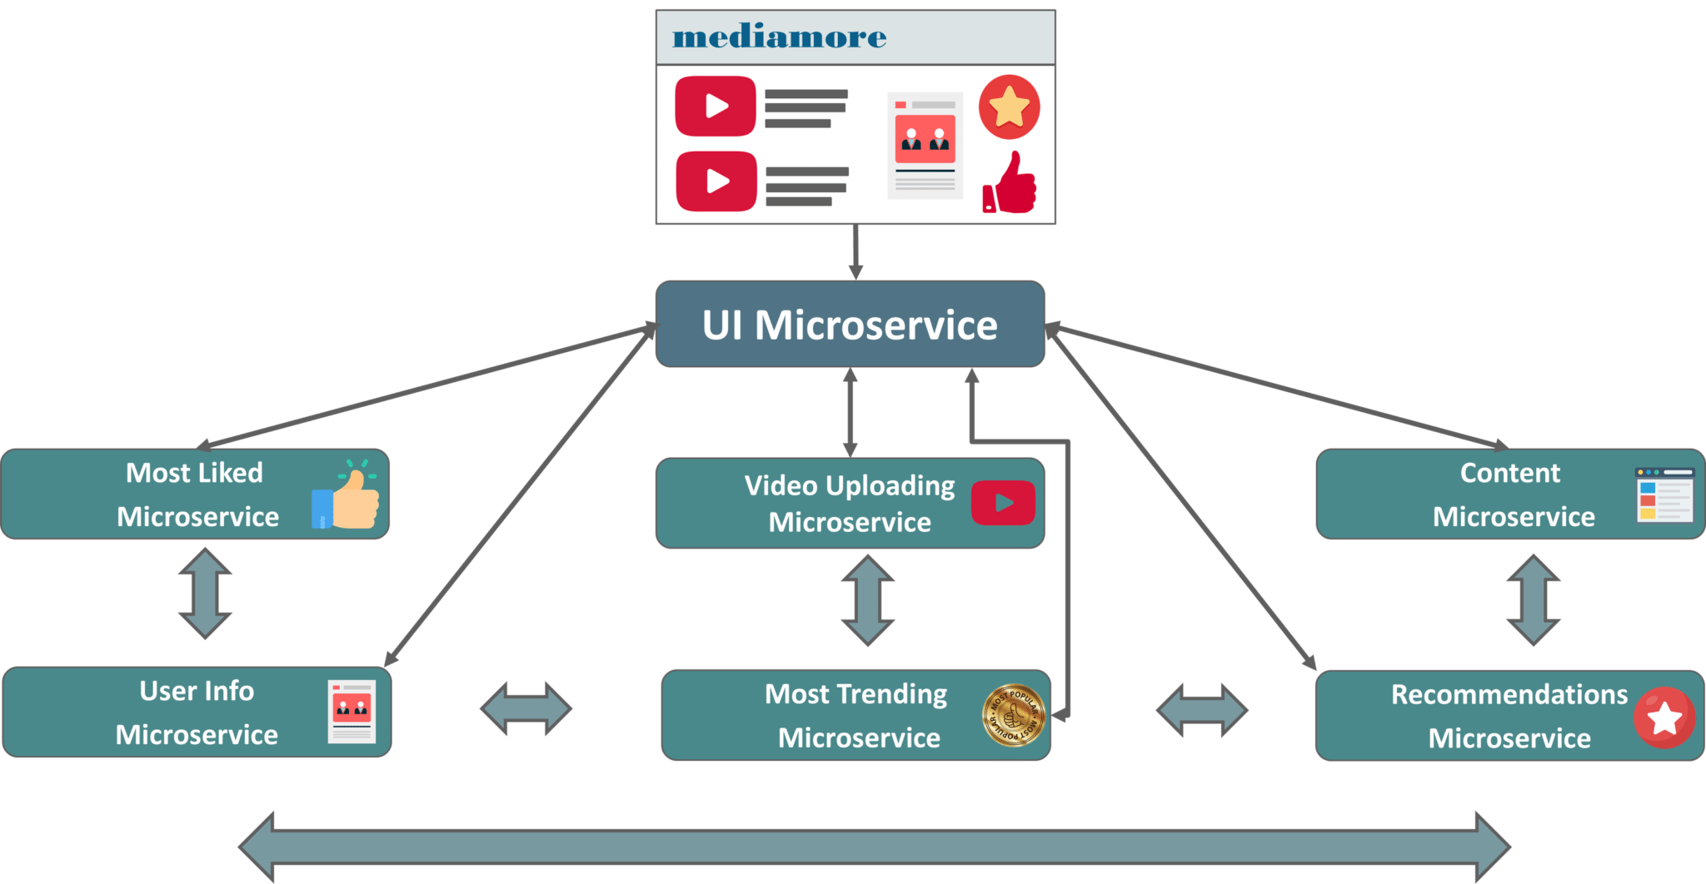
Microservices Architecture of Mediamore

Slide 47
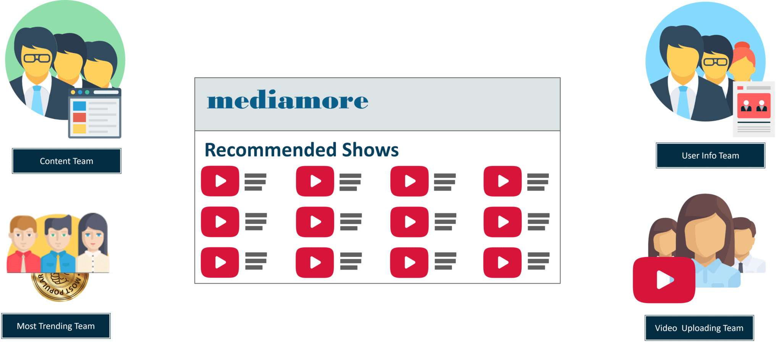
Division of Teams of Mediamore
Each microservice is handled by a small agile team such as content team, video uploading team, most trending team, search team etc.

Slide 48
Division of Teams of Mediamore
The content team consists of millions of TV Shows that the application provides.
The video uploading team have the responsibility to upload all the content into the application
The most trending team houses the most trending shows according to the geographical location of users and so on.
These small teams of developers relate each and every piece of content with the metadata that describes the searched content.
Then, metadata is fed into another microservice i.e. the search function which ensures Alice’s search results are captures into the content catalog.
Then, the third microservice i.e. most trending microservice captures the trending content among all the mediamore users according to their geographical locations.
The content from this microservice is what Alice sees when she first logs into mediamore.
These individually deployable microservices are put in specific containers to join the application.
Containers are used to deliver the code to the sector where deployment is required.
But before they join the application to work together, they have to find each other to fulfil Alice’s request.

Slide 49
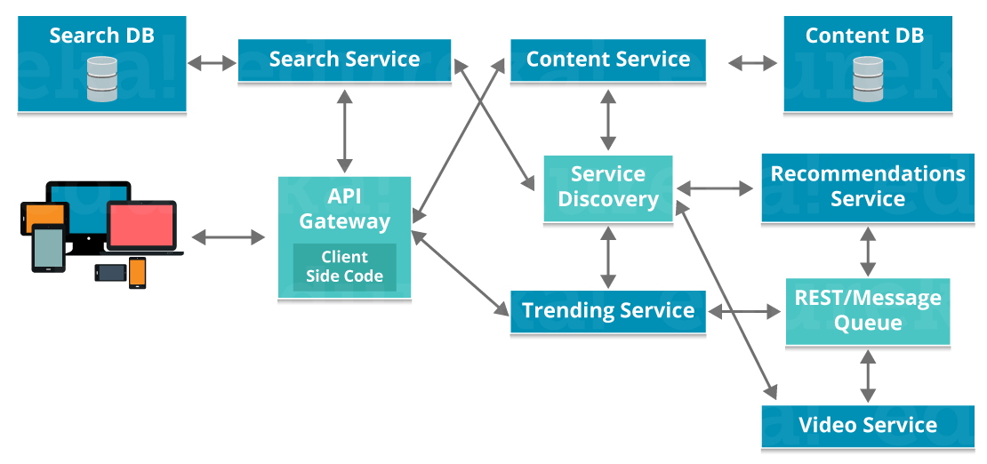
How do these microservices find each other?
Microservices use service discovery which acts as a guide to find the route of communication between each of them.
Microservices then communicate with each other via a stateless server i.e. either by HTTP Request/Message Bus.
These microservices communicate with each other using an API.
After the Microservices communicate within themselves, they deploy the static content to a cloud-based storage service that can deliver them directly to the clients via Content Delivery Networks (CDNs).

Slide 50
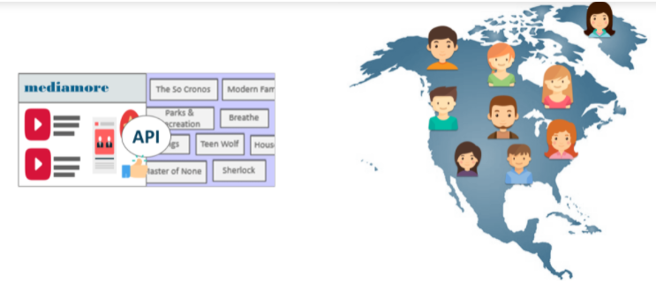
How do these microservices find each other?
So, when Alice searches for her TV Show, the search microservice communicates with the content catalog service in API about what is Alice searching for and then these microservices compare the typed words with the metadata they already have.
Once the teams of developers capture the most typed words by Alice,
The analytics team update the code in recommendations microservice and compare Alice’s most viewed content and preferences to popular content among other users in the same geographical region.

Slide 51
Microservices Monitoring
Monitoring is the control system of the microservices.
As the microservices are more complex and harder to understand its performance and troubleshoot the problems.
Given the vivid changes to software delivery, it is required to monitor the service. There are five principles of monitoring microservices, as follows:
Monitor container and what's inside them.
Alert on service performance.
Monitor services that are elastic and multi-location.
Monitor APIs.
Monitor the organizational structure.
These principles allow us to address technological changes associated with the microservices and organizational changes related to them.

Slide 52
Microservices Monitoring Tools
There are three monitoring tools are as follows:
Hystrix dashboard
Eureka admin dashboard
Spring boot admin dashboard

Slide 53
Components of Microservices
Spring Cloud Config Server
Netflix Eureka Naming Server
Hystrix Server
Netflix ZuulAPI Gateway Server
Netflix Ribbon
Zipkin Distributed Tracing Server

Slide 54
Spring Cloud and Netflix OSS
Netflix became one of the earliest adopters of microservices, having transitioned their monolithic application to a horizontally scalable, distributed architecture long before the term “microservices” gained any sort of traction.
Over the years Netflix have open-sourced a number of tools (that they continue to use internally) as part of the Netflix Open Source Software Center (Netflix OSS) project.
Many of these tools have been adopted by the Spring team as part of the Spring Cloud project, which provides tools to assist developers with some of the common patterns used when building distributed systems.

Slide 55
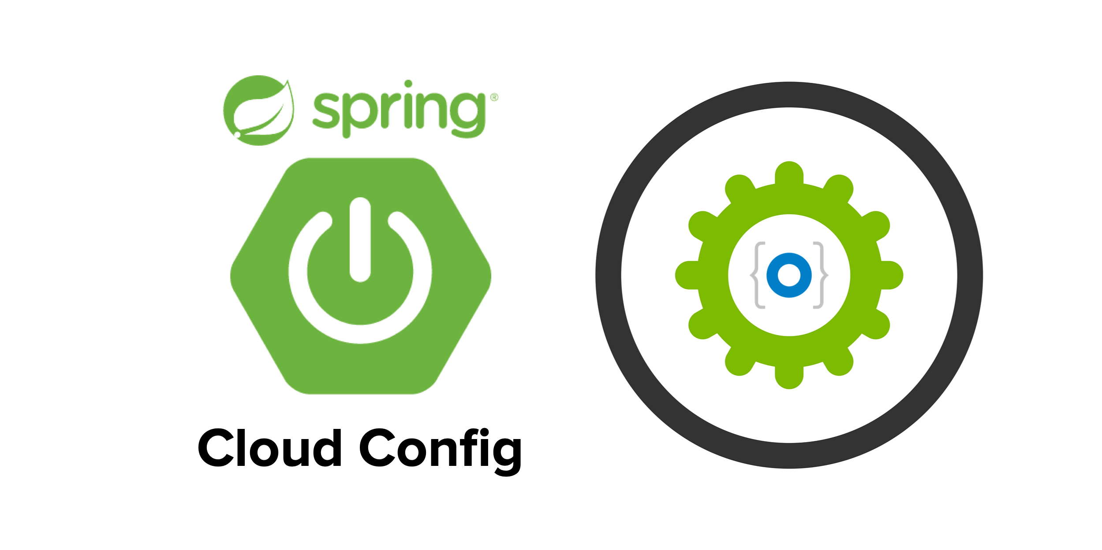
Components of Microservices
Spring Cloud Config Server
Spring Cloud Config Server provides the HTTP resource-based API for external configuration in the distributed system.
We can enable the Spring Cloud Config Server by using the annotation @EnableConfigServer.

Slide 56
Service Discovery
A microservice architecture can be incredibly dynamic.
Services don’t necessarily have fixed addresses, known ahead of time.
They can be moved around onto different ports, machines and even different data centres entirely.
More often than not, there will be many instances of a given service - a number that is rarely constant as new instances are often introduced to meet demand and are removed when demand decreases.
They also need to discover other services in order to communicate with them.

Slide 57
What is Service Registration & Discovery?
When you have multiple services running together within an application, they need to detect each other to communicate.
This the first and the most important feature of Microservices. In order to make it possible, there should exist one medium where all microservices register themselves.
Subsequently, when any service wants to communicate, it can connect to that medium and discovers other service to communicate.
This medium is nothing but ‘Service Registry & Discovery’ which is itself a microservice.
Moreover, this is similar to Java’s RMI mechanism, where you work with a central registry so that RMI processes could find each other. Microservices has the same obligation.

Slide 58
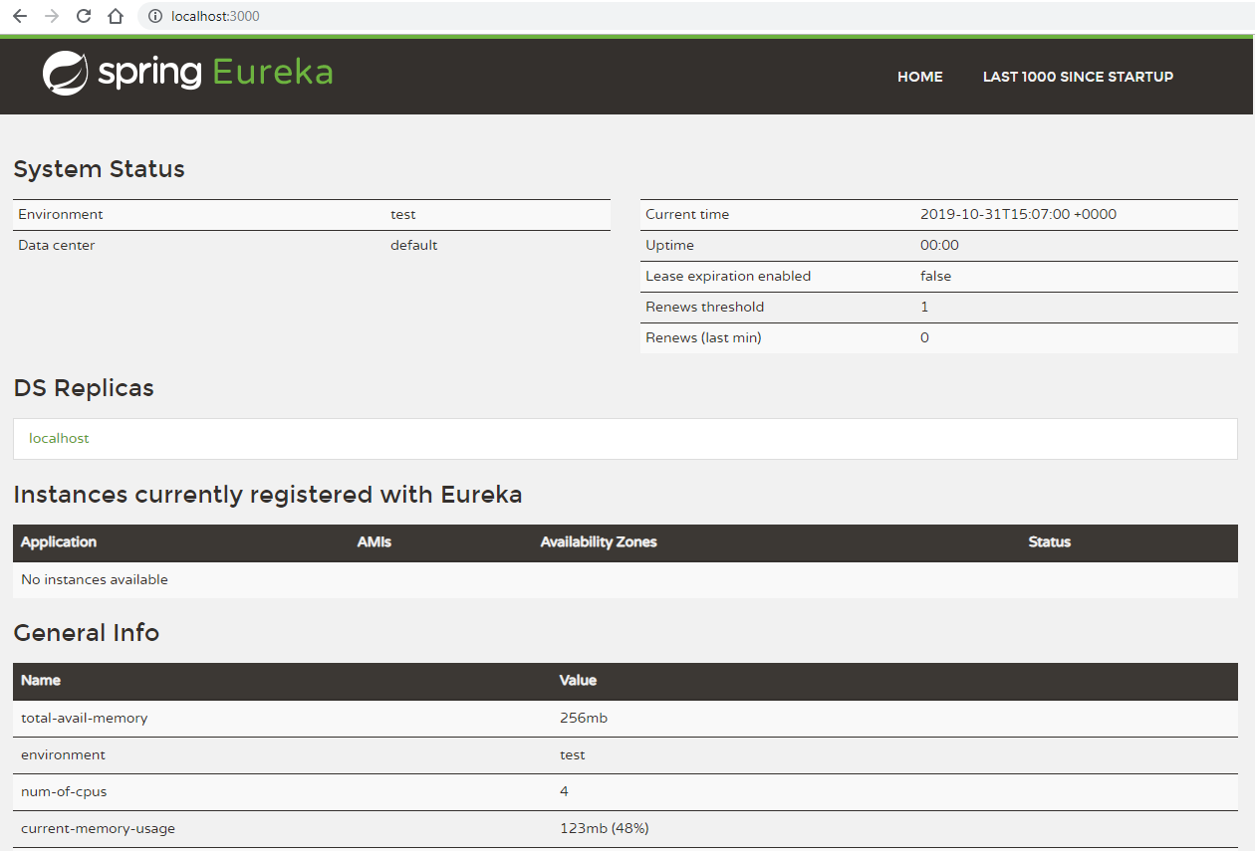
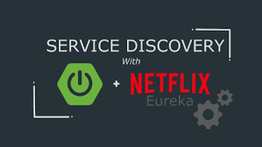
Components of Microservices
Netflix Eureka Naming Server
Netflix Eureka Server is a discovery server.
It provides the REST interface to the outside for communicating with it.
A microservice after coming up, register itself as a discovery client.
The Eureka server also has another software module called Eureka Client.
Eureka client interacts with the Eureka server for service discovery.
The Eureka client also balances the client requests.

Slide 59
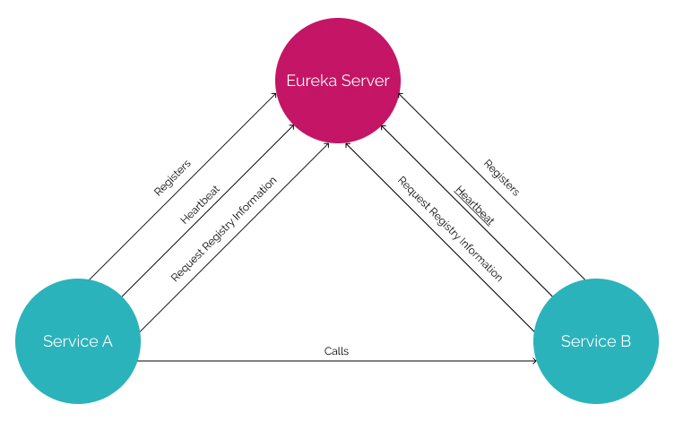
Discovery Service

Slide 60
Netflix Eureka
We use Netflix Eureka to make a kind of server which can register the microservices & discover them when required by the other microservice.
We call it Eureka Server or Discovery server.
Every Microservice will register into the Eureka server with a service Id and Eureka server will have information(port, IP addresses etc.) of all the microservices running as client applications.
Further, in order to implement it we create a microservice using Spring Boot project and include the below dependency mandatorily.
A service (Spring Boot Application in our case) annotated with @EnableEurekaServer will work as Eureka server.
<dependency>
<!-- Eureka for service registration -->
<groupId>org.springframework.cloud</groupId>
<artifactId>spring-cloud-starter-eureka-server</artifactId>
</dependency>

Slide 61
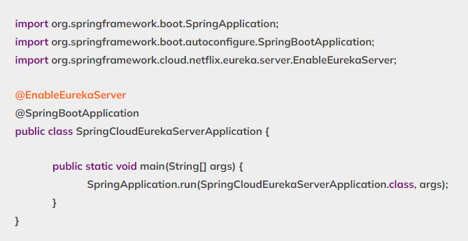
Apply Annotation @EnableEurekaServer at the main class

Slide 62
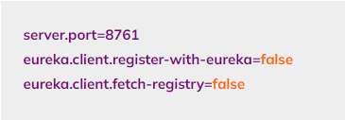
Modify application.properties file
Include ‘eureka.client.register-with-eureka=false’ for one time only in case of Eureka server as Eureka Server itself can’t be registered.
Eureka server will never try to fetch registry as it is itself having a registry.
eureka.client.fetch-registry=false
This property indicates that Eureka Server is supported to fetch instance details of microservice to make intra-communication between microservices happen.

Slide 63
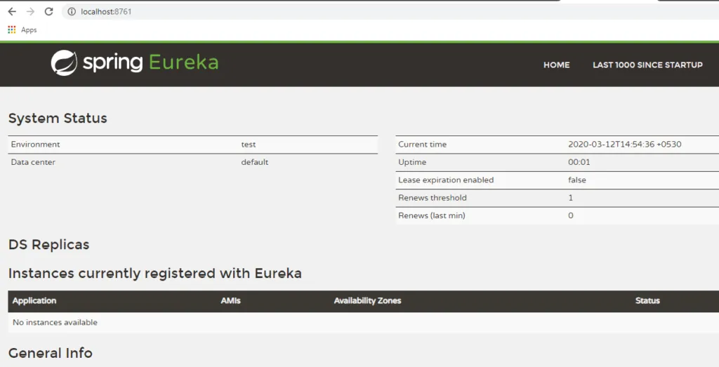
Running Eureka Server
You can see the Eureka Server console by accessing
URL- http://localhost:8761/

Slide 64
What is Microservices Intra-communication?
A published microservice communicates with the other microservice with the help of Eureka Server itself.
We use one Client to get details of a microservice from Eureka Server.
A service(Spring Boot Application in our case) annotated with @EnableEurekaClient will work as a Eureka Client application.

Slide 65
Micro Services Clients
DiscoveryClient (Legacy client) :
This is a basic client.
We register a Microservice in Netflix Eureka Server using Eureka Client.
It supports fetching Service Instances from Eureka server based on Service Id as List type.
Developer has to choose one instance with less load factor manually (no auto-balance concept supported) from the list of Service Instances.

Slide 66
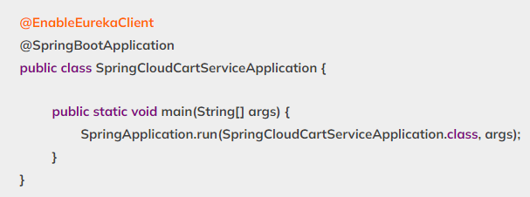
Apply Annotation @EnableEurekaClient at the main class
In order to make your application/microservice acts as a Eureka discovery client, you need to apply @EnableEurekaClient at the main class of your application.
<dependency>
<groupId>org.springframework.cloud</groupId>
<artifactId>spring-cloud-starter-netflix-eureka-client</artifactId>
</dependency>

Slide 67
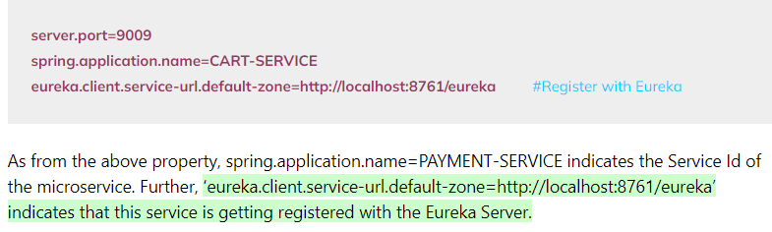
Modify application.properties file

Slide 68
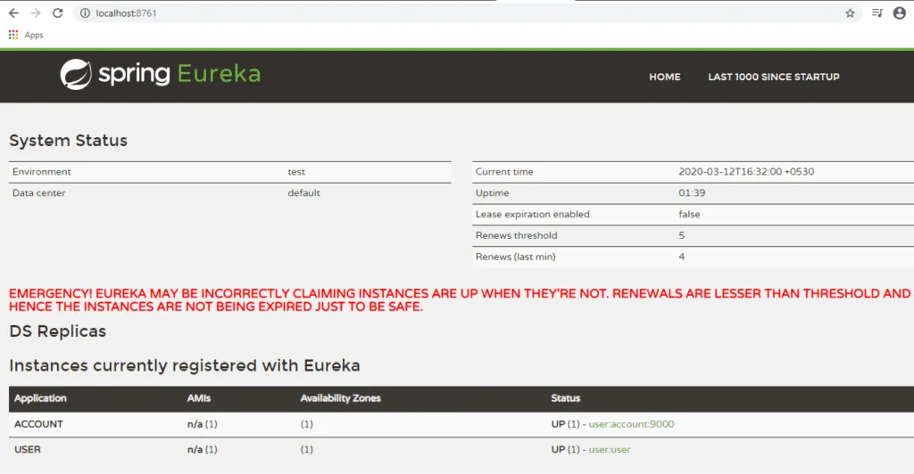
Registering Account Microservice as Eureka client
Run the SpringBootAccountApplication class to start this RESTful service. It will automatically be registered as Eureka client.
Verifying Eureka Server.
If you refresh the URL for Eureka Server- http://localhost:8761/ now you should see an instance registered.
Name of the instance is same as what was configured as a logical name using the property spring.application.name

Slide 69
RestTemplate
Rest Template is used to create applications that consume RESTful Web Services.
Spring Boot REST template was created to simplify REST services consumption in a Spring Boot application.
RestTemplate is a class which offers a method for calling REST API(Web API) and is a HTTP client offered by Spring Framework.
Spring-web library of Spring Framework is added to pom.xml for using RestTemplate.
<dependencies>
<dependency>
<groupId>org.springframework</groupId>
<artifactId>spring-web</artifactId>
</dependency>
</dependencies>

Slide 70
Methods of REST Template
RestTemplate offers multiple methods to send a GET request.
Usually, getForObject method or getForEntity method are used.
When a detailed setting such as setting a header is to be carried out, org.springframework.http.RequestEntity and exchange methods are used.
exchange() is the method used for making remote call to another microservice.

Slide 71
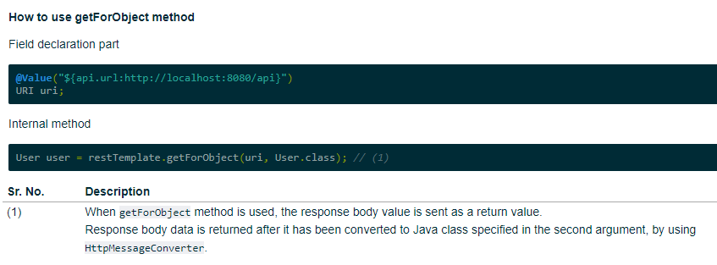

Slide 72
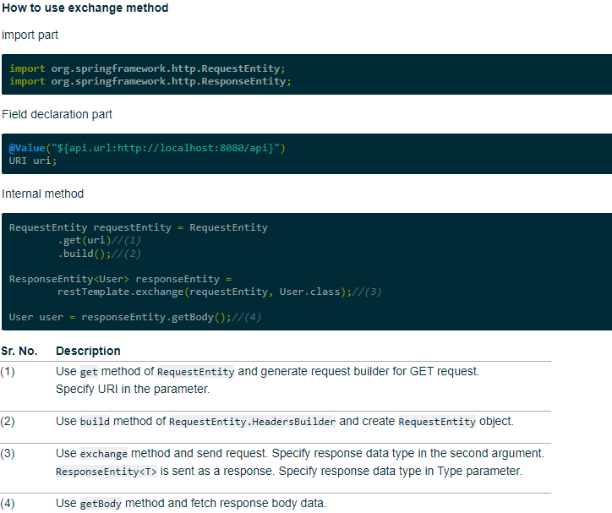
When a request header is to be specified, RequestEntity is generated and exchange method is used.

Slide 73
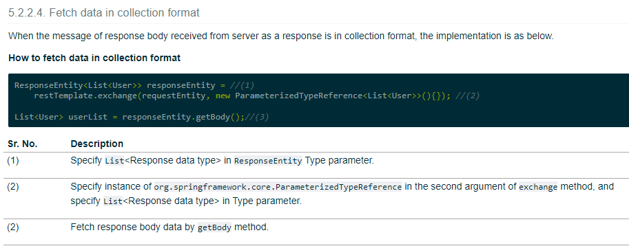

Slide 74
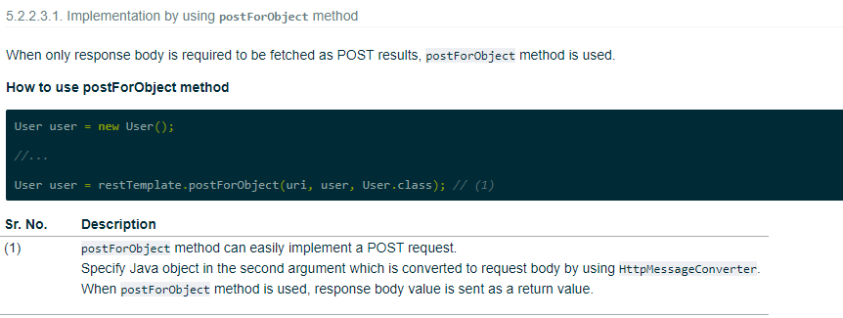

Slide 75
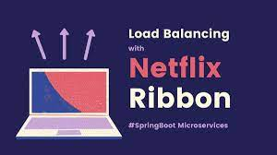
Components of Microservices
Netflix Ribbon
Netflix Ribbon is the client-side Inter-Process Communication (IPC) library.
It provides the client-side balancing algorithm.
It uses a Round Robin Load Balancing:
Load balancing
Fault tolerance
Multiple protocols(HTTP, TCP, UDP)
Caching and Batching

Slide 76
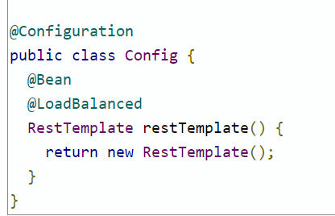
How to enable Load Balancer?
To avoid that hardcoding of URL used to call Micro service using Rest Template we are using Netflix’s Ribbon service which can be integrated with Eureka.
What we need to do is to mark a RestTemplate bean to be configured to use a LoadBalancerClient, to do that we can create RestTemplate bean as following.
Once we have this Load balanced restTemplate instance then you can use the logical name of the service, in the URL, that was used to register it with Eureka.
It will fetch only one Service Instance from Eureka based on Service Id that has less load factor.
LoadBalancerClient is an interface. Its implementation is provided

Slide 77


Slide 78
Implement Feign Client In Spring Boot Microservices
When two web applications communicate with each other for data exchange, they work on Producer-Consumer technique.
An application who produces data is known as a Producer/Provider application.
One who consumes data is known as Consumer application.
Java developer, might be very familiar with REST API for Producer application whereas RestTemplate for Consumer application.
With Microservices based application also, two Microservices communicate with each other and follow the Producer-Consumer model.
Here, in consumer side, we use a concept ‘Feign Client’ as a better option instead of RestTemplate in order to minimize our effort of coding.

Slide 79
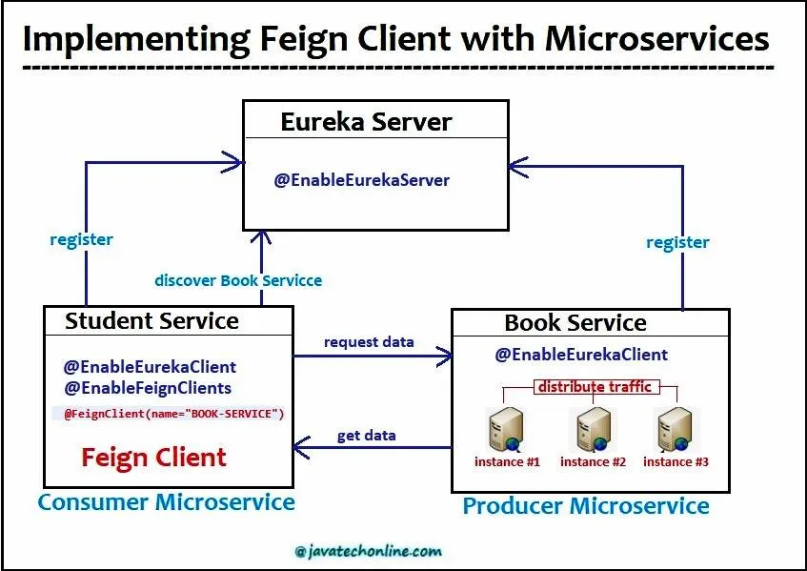
Apart from consuming REST services in an easy way, FeignClient/OpenFeign when combined with Eureka also offers us an easy load balancing.

Slide 80
What is Feign or Open Feign?
Feign is a declarative REST Client.
It makes writing web service clients easier. In order to use Feign, create an interface and annotate it.
Moreover, it internally generates a Proxy class at runtime using Dynamic Proxy Pattern.
It actually gets Application name(Service Instance) from Eureka and supports Making HTTP call.
We should use two annotations for this concept, they are:
@EnableFeignClients : To apply at starter class @FeignClient(name=”ApplicationName”) : To define an interface for a Consumer

Slide 81


Slide 82


Slide 83


Slide 84

Apply Annotation @EnableFeignClients at the main class

Slide 85

Implement Feign Client in Spring Boot Microservices
Programmatically, FeignClient is implemented as below.
@FeignClient(name=”ApplicationName”) : To define an interface for a Consumer

Slide 86

Create an interface as Consumer.java
This is the most important file when talking about Feign Client.
At Interface level, we need to apply @FeignClient annotation and provide the name of producer service/application as below.
Further, declare the methods as per the requirement.

Slide 87

RestController to receive data from Micro service using Feign Clent
At the end, create a RestController to receive the data from Book service data.
The important point to note here is that we need to auto-wire the Consumer here in this class and then use it.

Slide 88
How to test FeignClient Enabled Microservice
Start Service/Application containing Eureka Server
Start Producer Service/Application (Book)
Start Consumer Service/Application (Student)
Open a browser window, hit below URLs and observe the results. For Eg:
http://localhost:9100/student/data
http://localhost:9100/student/allBooks
http://localhost:9100/student/getOneBook/501
http://localhost:9100/student/entityData

Slide 89

Components of Microservices
Hystrix Server
Hystrix server acts as a fault-tolerance robust system.
It is used to avoid complete failure of an application.
It does this by using the Circuit Breaker mechanism.
If the application is running without any issue, the circuit remains closed.
If there is an error encountered in the application, the Hystrix Server opens the circuit.
The Hystrix server stops the further request to calling service. It provides a highly robust system.

Slide 90
Implement Hystrix Circuit Breaker In Microservices
Microservices based applications feature a huge amount of distributed components.
These components interact with each other during the request processing.
As the number of interactions over the network increases the possibility of an abnormal behavior of a service may also increase.
In that case we need to have some handy techniques that can prevent or minimize this abnormal behavior.
Its none other then than a fault-tolerance mechanism.
The circuit breaker is fault-tolerance technique that monitors and detects when a service is behaving abnormally.
It temporarily rejects those calls until the service becomes healthy again.
Netflix Hystrix is an open source library which provides this solution.

Slide 91


Slide 92
Introduction to Hystrix
Netflix has provided a bunch of libraries to form an ecosystem in microservices.
Like Eureka, Hystrix is also an open source library provided by Netflix in the Microservices space.
Hystrix implements the Circuit Breaker pattern.
You don’t have to write the network or thread programming to handle fault tolerance in the Microservices.
You need to use Hystrix library just by giving parameters and that’s it. Hystrix is going to do all the work for you internally.
The best part of it is that it works amazingly with Spring Boot.
If you pick any Microservice based project, there are pretty good chances that they are using Hystrix.

Slide 93
What is Circuit Breaker in Microservices?
In a microservice based application, Circuit Breaker is a technique, where we stop executing an erroneous method and redirect every request to a custom method (Fallback method).
Generally, we stop execution of a particular method if it is continuously throwing an exception.
When we break the circuit, we also avoid any cascading failures to the downstream services.
Its basic function is to interrupt current flow after a fault is detected.
A circuit breaker can be reset to resume normal operation either manually or automatically.

Slide 94
What is a Fallback Method in Microservices?
If an actual method of a microservice is throwing exception continuously, then we avoid execution of the actual logic for some time.
Instead, we redirect the request to a Dummy method that provides the response back to client’s request.
Such dummy method is called as Fallback method.
This method can provide dummy responses such as ‘Service Not Working’, ‘Unable to Process’, ‘try after some time’ etc.

Slide 95
Why do we need a Circuit Breaker?
It’s very common for software applications to make remote calls to a software program, possibly running on different machines across a network.
One of the big differences between in-memory calls and remote calls is that remote calls may fail, or hang without a response until some timeout limit is reached.
What’s worse, if you have many requests on an unresponsive service, then you can run out of critical resources leading to cascading failures across multiple systems.
The basic idea behind the circuit breaker is very simple.
You wrap a protected function call in a circuit breaker object, which monitors for failures.
Once the failures reach a certain threshold, the circuit breaker falls.

Slide 96
What are the states of Circuit Breaker?
Depending on the state, Circuit Breaker changes its behaviour. There are three states of a Circuit Breaker.
Closed
If Client request is sent to the actual service method only, then it is called as CLOSED CIRCUIT.
Hence, this state represents that the service is running properly and providing the expected functionality.
Open
If Client request is redirected to Fallback method, then such case is an OPEN CIRCUIT.
Hence, this state represents that service is unavailable or faulty and error rate is beyond the threshold.

Slide 97
What are the states of Circuit Breaker?
Half-Open
Once the state becomes OPEN, we wait for some time in the OPEN state.
After a certain period of time, the state becomes HALF_OPEN.
During this period, we do send some requests to Service to check if we still get the proper response.
If the failure rate is below the threshold, the state would become CLOSED.
If the failure rate is above the threshold, then the state becomes OPEN once again.
This cycle continues till the service becomes stable.

Slide 98
How to Implement Hystrix Circuit Breaker in Microservices
Step #1 : Create a Spring Boot Project in STS(Spring Tool Suite)
Here, we will use STS(Spring Tool Suite) to create our Spring Boot Project. If you are new to Spring Boot, visit Internal Link to create a sample project in spring boot using STS.
While creating a project in STS add starters ‘Hystrix’, ‘Hystrix Dashboard’, ‘Spring Web’, ‘Spring Boot Actuator’ in order to get features of it.
Note : It is just a recommendation to please modify spring cloud version in pom.xml as below. <spring-cloud.version>Hoxton.SR4</spring-cloud.version>

Slide 99

Hystrix Configuration

Slide 100

Hystrix Circuit Breaker Example - Demo

Slide 101
Create Student Service
Create spring boot project.
Add server & application settings in properties file.
Create REST APIs using RestController.
Build and Test Student Service

Slide 102
Create School Service – Hystrix Enabled
Generate spring boot project
Create a Spring boot project from Spring Boot initializer portal with these dependencies mainly.
Web – REST Endpoints
Actuator – providing basic management URL
Hystrix – Enable Circuit Breaker
Hystrix Dashboard – Enable one Dashboard screen related to the Circuit Breaker monitoring
Open application.properties and add port information.

Slide 103

How to Implement Hystrix Circuit Breaker in Microservices
Step #2: Apply Annotation @EnableHystrix and @EnableHystrixDashboard at the main class
In order to implement Circuit Breaker in your application/microservice, you need to apply @EnableHystrix at the main class of your application.
To see the analytics provided by Hystrix as a dashboard, apply @EnableHystrixDashboard at the main class.

Slide 104

How to Implement Hystrix Circuit Breaker in Microservices
Add REST controller -
Add SchoolServiceController Rest Controller where we will expose /getSchoolDetails/{schoolname} endpoint which will simply return school details along with its student details.
We will create a Delegate layer StudentServiceDelegate.java to call the Student Service.

Slide 105

Delegate Layer to enable Hystrix circuit breaker

Slide 106

Hystrix circuit Breaker with:
Rest Template,
Service Method to fetch REST data &
A fallback method to be invoke , if the Service is unavailable.

Slide 107


Slide 108

Circuit in Open State – Executes FallBack method

Slide 109

Hystrix Dashboard
As we have added hystrix dashboard dependency, hystrix has provided one nice Dashboard and a Hystrix Stream in the bellow URLS:
http://localhost:9098/hystrix – This is visual dashboard initial state.

Slide 110

Dynamic Visual Representation of the Circuit
Now add http://localhost:9098/hystrix.stream in dashboard to get a meaningful dynamic visual representation of the circuit being monitored by the Hystrix component.
Visual Dashboard after providing the Stream input in the home page

Slide 111

Components of Microservices
Netflix Zuul API Gateway Server
Netflix Zuul Server is a gateway server from where all the client request has passed through.
It acts as a unified interface to a client.
It also has an inbuilt load balancer to load the balance of all incoming request from the client.

Slide 112
Netflix Zuul API Gateway Server
Create load balancer using Netflix Zuul and its solid bonding with Spring Cloud.
It is a API gateway pattern.
We can create a microservice ecosystem and test its effectiveness and applicability of Zuul API gateway in the whole ecosystem.
This is a very common microservice pattern and Netflix, creator of Zuul makes use of this heavily and intelligently.
Netflix claims that all Netflix traffic first go to a Zuul cluster which is mainly responsible for dynamic routing, monitoring, resiliency and security based on different groovy based custom filters.

Slide 113


Slide 114
Where Zuul fits in microservices ecosystem?
A common problem, when building microservices, is to provide a unique gateway to the client applications of your system.
The fact that your services are split into small microservices apps that shouldn’t be visible to users otherwise it may result in substantial development/maintenance efforts.
Also there are scenarios when whole ecosystem network traffic may be passing through a single point which could impact the performance of the cluster.
To solve this problem, Netflix (a major adopter of microservices) created and open-sourced its Zuul proxy server and later Spring under Pivotal has adapted this in its spring cloud stack and enabled us to use zuul easily and effectively with just few simple steps.

Slide 115
Itroduction to Zuul
Zuul is an edge service that proxies requests to multiple backing services.
It provides a unified “front door” to your ecosystem, which allows any browser, mobile app or other user interface to consume services from multiple hosts.
You can integrate Zuul with other Netflix stack components like Hystrix for fault tolerance and Eureka for service discovery or use it to manage routing rules, filters and load balancing across your system.
Most importantly all of those components are well adapted by spring framework through spring boot/cloud approach.

Slide 116


Slide 117

Zuul Components

Slide 118

Request Processing flow inside Zuul with different filters

Slide 119

Netfilx Zuul - Demo
We will create below artifacts to demonstrate the Microservices with Zuul Gateway.

Slide 120

Responsibility of Gateway Service

Slide 121
Create Zuul Gateway Service Proxy
This will be again a spring boot based microservice, but it has a special feature.
It will use zuul to create a API gateway proxy which will proxy the student service.
Later we can add any number of microservices like student service and able to create a strong microservice ecosystem.
Create a Spring boot project from spring initializer portal with Zuul dependency.
<dependency>
<groupId>org.springframework.cloud</groupId>
<artifactId>spring-cloud-starter-netflix-zuul</artifactId>
</dependency>

Slide 122

Enable Zuul Service Proxy
Add the @EnableZuulProxy annotation on Spring boot application.
This artifact will act like a Zuul service proxy and will enable all the features of a API gateway layer as described before.
We will then add some filters and route configurations.

Slide 123

Zuul Filters and Route Configurations
It is still a good practice to always make a Zuul Filter in the application.
This is due to the reason that in the filer, we can do anything with the incoming requests like analyzing response time, logging, metric etc.
Here, we just log the incoming request along with its timestamp and request URL.

Slide 124

Create Reverse Proxy- Gateway
We make this application a reverse proxy so that it can forward the requests to other microservices by injecting a bean of Zuul Filter.

Slide 125

Zuul routes configuration

Slide 126

Netflix zuul example Demo
We have enabled Zuul, added required configurations and developed Filters.
So now we can do the basic testing to understand the whole thing.
Deploy the project.
Once the server started, go to browser and test whether the endpoints are working by accessing the student service but it’s name i.e. /student.
http://localhost:8080/student/getStudentDetails/

Slide 127

Components of Microservices
Zipkin Distributed Server
Zipkin is an open-source project.
That provides a mechanism for sending, receiving, and visualization traces.

Slide 128
Implement Distributed Logging & Tracing Using Sleuth & Zipkin
In Microservices Architecture based Applications, there are multiple services which interact with each other.
In order to serve a client request, one request may involve multiple microservices call to get the response.
If any exception occurs or any latency issue appears during such calls, then how will we identify the root cause of the issue?
Of course, we will make use of Spring Cloud Sleuth & Zipkin to support distributed logging & Tracing.
So we will check How to implement Distributed Logging & Tracing using Sleuth & Zipkin’ and related concepts accordingly.

Slide 129
Exceptions in Micro Services EcoSystem
If we are working on a Standard application, we can implement logging by adding one log file to identify any exception or other issues like response timings or latency etc.
However, in case of Microservices based applications, there are multiple small applications.
Therefore, we will have to maintain multiple log files such as at least one log file per application.
In this case, correlating the logs to a particular request chain becomes difficult.
Hence, identifying the root cause of the issue also becomes complicated.
In order to overcome from such kind of issues, we make use of Spring Cloud Sleuth and Zipkin.
Let’s see ‘How to Implement Distributed Logging & Tracing using Sleuth & Zipkin?’ And related concepts accordingly

Slide 130


Slide 131
What is Logging & Tracing?
Tracing : Tracing is a process of finding an execution path or a flow of multiple microservices to serve a request.
Logging : Logging is a process of admitting all log messages for a trace. These messages can be of any type such as DEBUG, INFO, WARN, ERROR etc.
We will be implementing Logging and Tracing for multiple Microservices involved in serving one request.
We also call it ‘Distributed Tracing and Logging’.
Once it is implemented one time, then developer doesn’t need to check the code again to find the flow either for testing purpose or for debug purpose.

Slide 132
What is Sleuth and Zipkin used for ?
Sleuth : Sleuth provides unique ids for the request flow.
Further, the developer uses these ids to find out the flow of execution with the help of tools like Zipkin, ELK etc.
Generally it has two ids : Trace id and Span Id.
Trace Id is applicable for a complete flow.
If the developer gets this Id, he/she can find the flow of execution in all microservices involved.
However, Span Id is applicable to the flow of one microservice.
If the developer gets this Id, he/she can find the flow of execution in a particular microservice.
Moreover, there is a concept of parent id which is applicable to a particular microservice like span id.

Slide 133

What is Sleuth and Zipkin used for ?
During the flow of execution, span id of the previous microservice becomes the parent id of the next microservice as shown below.

Slide 134
What is Sleuth and Zipkin used for ?
Zipkin : We use Zipkin in two parts :
Zipkin Client and Zipkin Server.
Zipkin Client contains Sampler which collects data from microservices with the help of Sleuth and provides it to the Zipkin Server.
In order to utilize the benefits of both tools, we should always add Zipkin Client’s dependency along with Sleuth in every microservice.
However, there must be only one centralized Zipkin Server, which collects all data from Zipkin Client and display it as a UI.
Hence, after making a request developer should look into Zipkin Server to find trace id, span id and even flow of execution.
From here itself, Open Log files to check Log lines that are related to the current trace Id.

Slide 135
How to download & setup Zipkin Server?
In order to check the flow of execution in microservices chain, we need to download & setup Zipkin Server in our system. Follow below steps to get it done.
1) Download ZIPKIN from the Link below: Zipkin https://www.mediafire.com/file/jmpqrenm0yudehy/ZipkinExecutable.zip/file
2) Extract to a folder ‘ZipkinExecutable’. The downloaded file name should be like ‘ZipkinExecutable.zip’
3) Open command prompt at the above location where your extracted folder exists. For example: Let’s assume that your location is C:/Downloads/ZipkinExecutable/>
4) Run Jar file by using below command: >java -jar zipkin-server-2.12.9-exec.jar If Zipkin Server started successfully, you will see message something like “Started ZipkinServer in 14.094 seconds (JVM running for 15.452)”
5) Open your Browser and Enter URL: http://localhost:9411/zipkin/
6) Click on ‘Find Traces’ button. It will display ‘Showing: 0 of 0‘

Slide 136
Implement Distributed Logging & Tracing using Sleuth & Zipkin
In order to implement Distributed Logging & Tracing, we will do three major tasks as below:
Develop three Microservices applications using Spring Boot which will interact with each other.
Implement distributed logging & tracing using Spring Cloud Sleuth.
Test distributed logging & tracing using Zipkin Server

Slide 137
Step 1 - Create a Spring Boot Project using STS
Use STS(Spring Tool Suite) to create our Spring Boot Project.
If you are new to Spring Boot, visit Internal Link to create a sample project in spring boot using STS.
While creating a project in STS add starters ‘Sleuth’, ‘Zipkin Client’, ‘Spring Web’ in order to get features of them.

Slide 138


Slide 139

Step#3: Create AppConfig.java to Setup Configurations

Slide 140

Step#4: Write a RestController to implement a Microservice

Slide 141

Step#5: Write two more applications just like above
Create multiple applications. For example, let’s say MyServiceTwo and MyServiceThree.
However, Config Files will be similar but properties may differ.
Also change the code of RestController accordingly.

Slide 142
How to test the application as a whole ?
Start Zipkin Server
Start All Microservices one by one
Enter URL: http://localhost:8081/m1
Open a new browser window and enter http://localhost:9411/zipkin
Click on Find Trace. You will see details of three running microservices highlighted in green color.
Click on Blue color bar. You will see trace record of each microservice.
Click on any one option. Let’s click on ‘microservice#2’. A new popup window will appear with all the details.
Click on ‘Show IDs’, you will find details of traceId, spanId and parentId. Now, copy traceId from here.
Open Log files and search(ctrl+F) with traceId to see all log lines related to current request.

Slide 143

Analysing Zipkin Dashboard
For example, once we enter URL ‘http://localhost:9411/zipkin’ and click on ‘Find traces’ button, we will see below screen.

Slide 144

Analysing Zipkin Dashboard
Click on blue bar just above the microservices highlighted in green color. We will get a screen something like below.

Slide 145

Analysing Zipkin Dashboard
In order to find out the trace Ids for a particular microservice click on any microservice as highlighted above.
For example, we click on microservice#2.
Now, We will get a popup window something like below.

Slide 146
Components Port Numbers
Application | Port
Spring Cloud Config Server | 8888
Netflix Eureka Naming Server | 8761
Netflix Zuul API gateway Server | 8765
Zipkin distributed Tracing Server | 9411

Slide 147


Slide 148


